Slide 1



Road Accident
View in Power BI
Last data refresh:
10/28/2023 2:29:44 PM UTC
Downloaded at:
10/28/2023 2:55:13 PM UTC

Slide 2
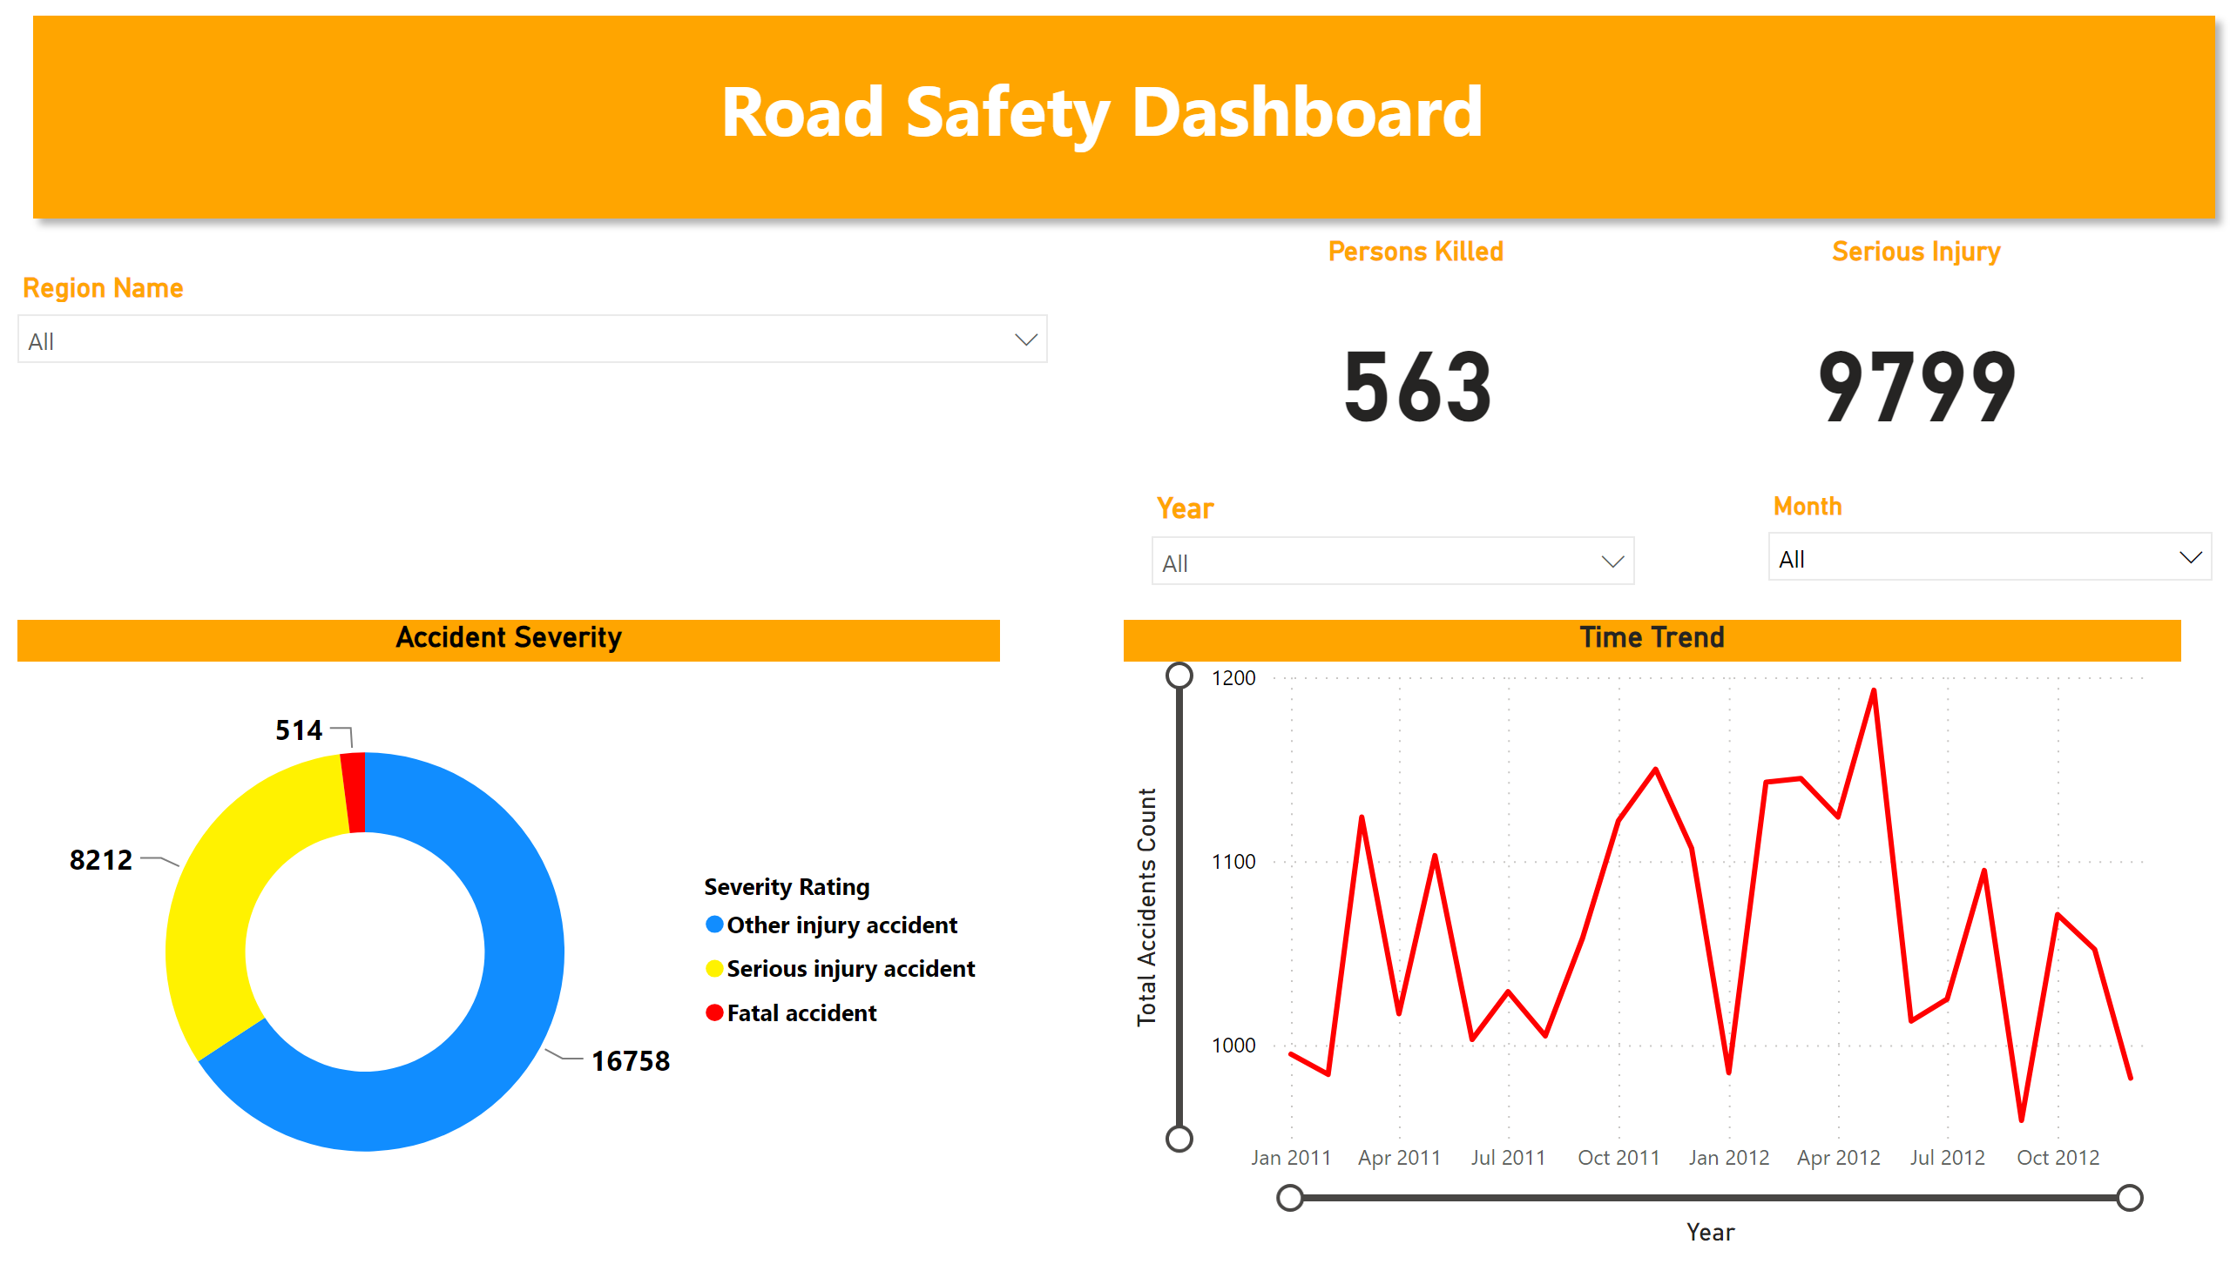
Dashboard Main
Notes:
shape
No alt text provided
Time Trend
No alt text provided
slicer
No alt text provided
Serious Injury
No alt text provided
Persons Killed
No alt text provided
Accident Severity
No alt text provided
Select Month
No alt text provided
slicer
No alt text provided

Slide 3
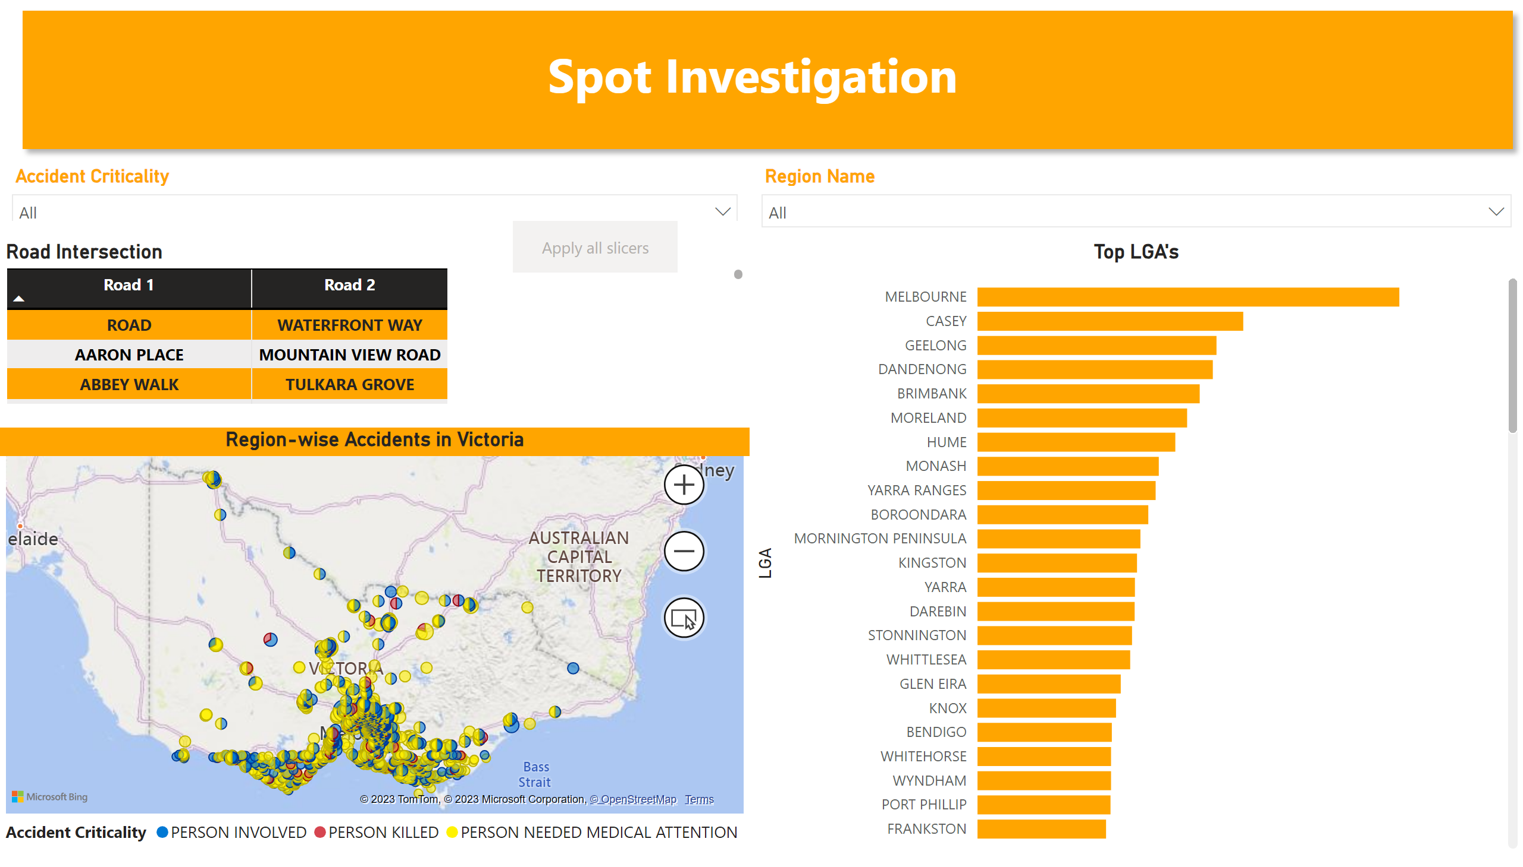
Spot Investigation
Notes:
Region-wise Accidents in Victoria
No alt text provided
slicer
No alt text provided
slicer
No alt text provided
Top LGA's
No alt text provided
shape
No alt text provided
Road Intersection
No alt text provided
actionButton
No alt text provided

Slide 4
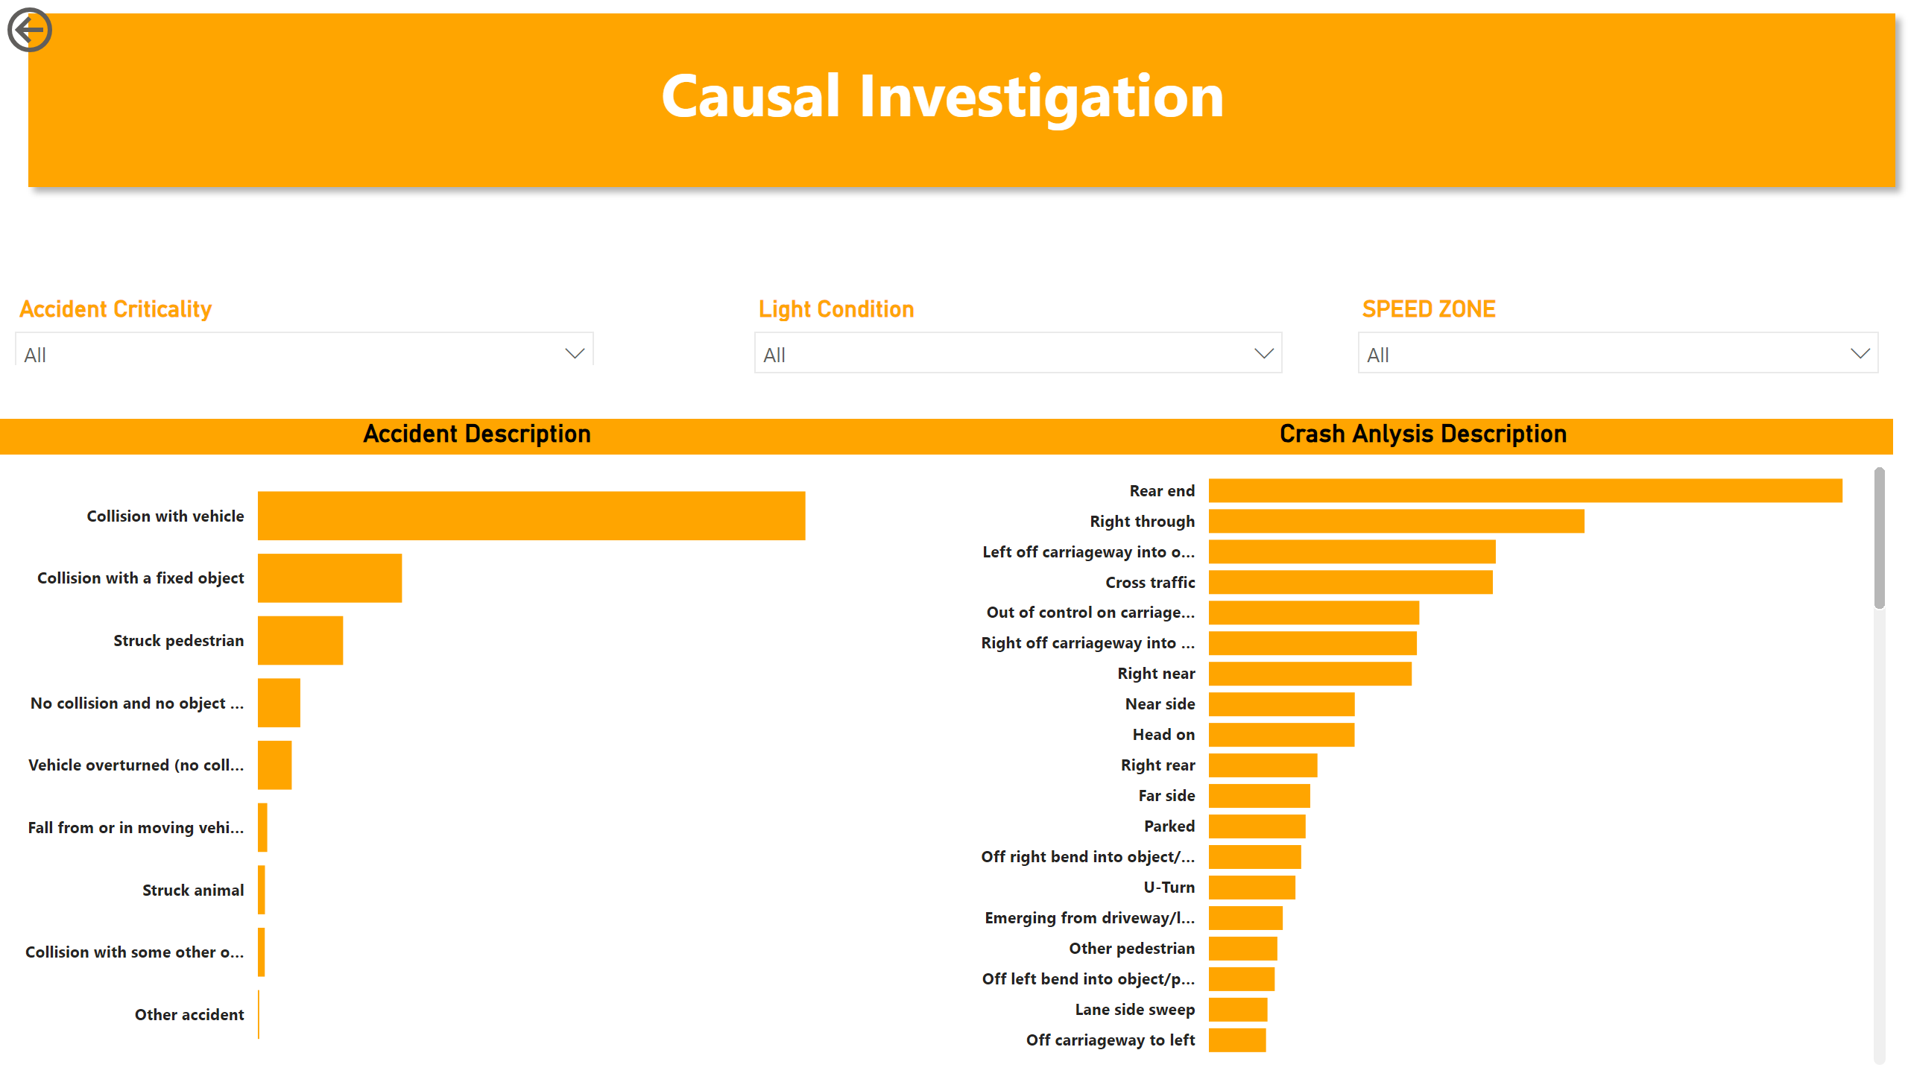
Causal Investigation
Notes:
shape
No alt text provided
Accident Description
No alt text provided
actionButton
No alt text provided
Crash Anlysis Description
No alt text provided
slicer
No alt text provided
slicer
No alt text provided
slicer
No alt text provided

